Slide 1
RASPBERRY PI PROJECT
Erasmus+ Romanian students (Pitești)
Nicolescu Mihai-Robert
Marin Marian Puiu
Ene Remus Ionut
Nedelea Eugen Cristian
Oprea Alexandra Catalina
Year: 2
Lecturer: Irena Valova

Slide 2
Who has worked on what:
Nicolescu Mihai-Robert - Setting up the RPI, Python script, Back-End, Documentation
Marin Marian Puiu - Front-End, Back-End
Ene Remus Ionut - Back-End
Nedelea Eugen Cristian - Front-End
Oprea Alexandra Catalina - Front-End

Slide 3
What we’ll talk about:
What tech we’ve used
Sensors
Logic
Website architecture
Database
Front - end
Back - end:
Python
PHP sessions
Cookies
Use cases
Features

Slide 4
Tech we’ve used
Front-End:
HTML
CSS
Bootstrap
Back-End:
Apache2
PHP
MYSQL
Python 3
Javascript

Slide 5
Sensors - BH1750
This is a light sensor. It has a lux meter which can measure the light’s intensity without calculations.
We can say, for example, that when the light sensor reads more than 5lx we should turn on the lamp in the room because it’s dark. (for reference, 0lx means complete darkness).

Slide 6
Sensors - BME280
The BME280 is as combined digital humidity, pressure and temperature sensor based on proven sensing principles.
Here’s an example of a reading from the sensor:
humidity level 83.7%
pressure level 999.1 hPa
temperature 24.4C

Slide 7
The logic

Slide 8
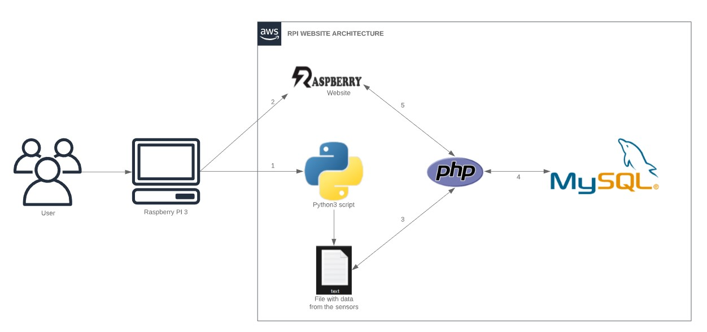

Slide 9
The python script outputs the data we need every few seconds in a file(to avoid data repetition in the datasets table when using the site rapidly).
Then, using PHP we put that data in a table in the local database, and then we show the table on the page.
The website compares the most recently read data from the table with the bounds set by admin and decides if the LEDs should turn on or off.
Data is inserted into the table every time the page refreshes, so we told the page to refresh every 300 seconds (5 minutes).

Slide 10
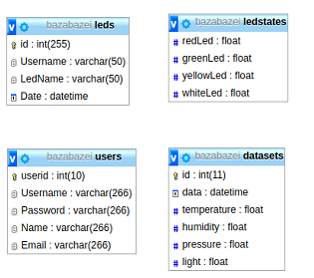
Database
PHP puts data in the MYSQL tables.
Because we didn’t have any complicated query to do, we’ve decided that we have no reason to connect the tables.
Users has info about the users
Datasets keeps track of the data read by the sensors
Ledstates keeps track of the bounds set by the admin for the sensors
Leds keeps track of who turned on/off a LED

Slide 11
Front-End
For the Front-End, we’ve decided to go with a simple and clean bootstrap template. Being easy to use, we didn’t have a lot of problems getting it to look exactly how we wanted.
We’ve also decided that the most relevant data to show on the page are the most recent 10 readings of the sensors.

Slide 12
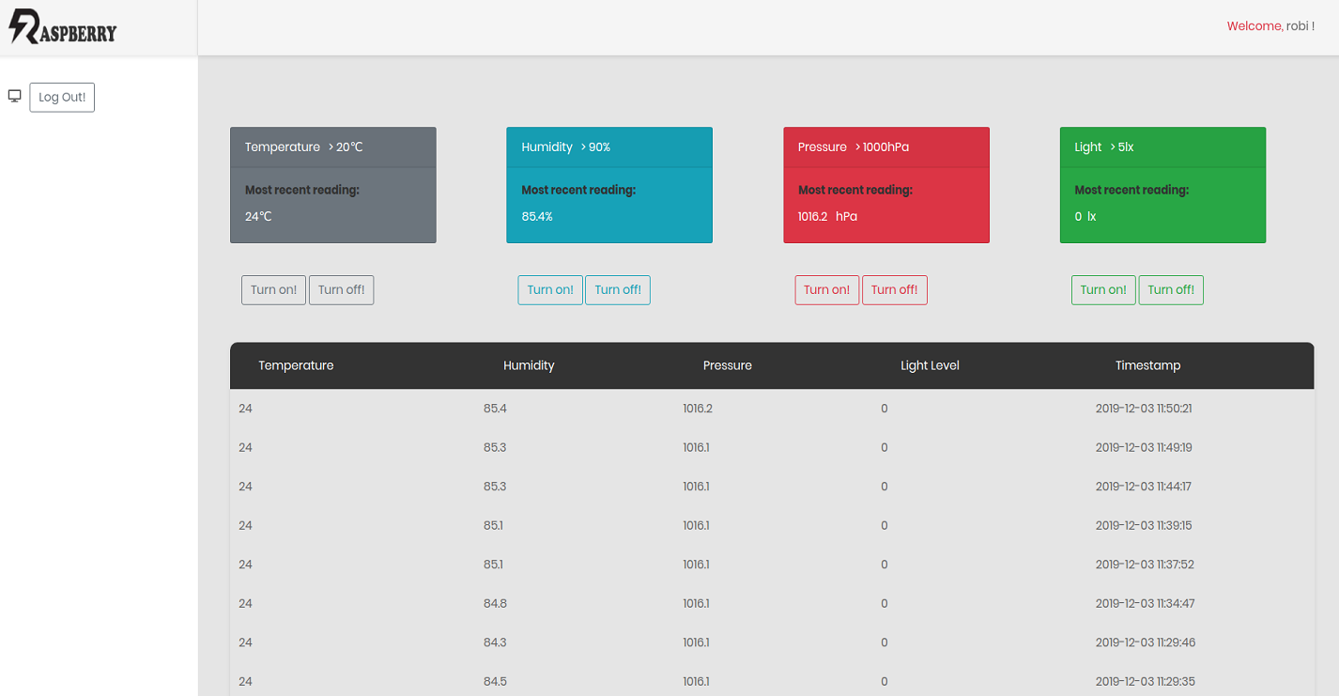

Slide 13
Back-End - general info
The server runs on apache2 combined with PHP/MYSQL. These were installed using the terminal.

Slide 14
Back-End - Using Python #1
Reading the data from BME280 was pretty easy (with the help of import adafruit_bme280), needing only 3 lines of code:
i2c = busio.I2C(board.SCL, board.SDA)
bme280 = adafruit_bme280.Adafruit_BME280_I2C(i2c)
list = [bme280.temperature, bme280.humidity, bme280.pressure]

Slide 15
Back-End - Using Python #2
Solution() puts the list of data into a string where the numbers are separated by a comma (e.g: 11.67,23.6,62.9,1010.6) and the lines of code afterwards put this string into a file every 3 seconds.
11.67 is the light level
23.6 is the temperature
62.9 is the humidity
1010.6 is the pressure
def solution():
list = SensCheck()
my_string = ','.join(map(str, list))
return(my_string)
def fisier():
f=open('date.txt',"w+")
lista = solution()
#print(lista)
f.write(lista)
f.close()
while (True):
fisier()
time.sleep(3)

Slide 16
Back-End - PHP
When someone registers, their info gets added to the users table.
Also, the user’s password is hashed in the database.

Slide 17
Back-End - PHP Register
<?php
require 'conectare.php';
if(!empty($_POST['Name'])&& !empty($_POST['Password'])&& !empty($_POST['Email'])&& !empty($_POST['Username'])&&
isset($_POST['Name'])&& isset($_POST['Password'])&& isset($_POST['Email'])&& isset($_POST['Username']))
{
$username = strtolower($_POST['Username']);
$password = $_POST['Password'];
$email = $_POST['Email'];
$name = $_POST['Name'];
$password_hashed = password_hash($password, PASSWORD_DEFAULT);
$sql = "SELECT Username from users where Username='$username'";
$result = mysqli_query($conectare, $sql);
$check = mysqli_num_rows($result);
if($check>0){
header("Location:indexsignup.php?Info=exista");
die();
} else{
$sql = "INSERT INTO users(Username,Password,Email,Name) VALUES ('$username' , '$password_hashed' , '$email' , '$name')";
$result = mysqli_query($conectare, $sql);
header("LOCATION:indexsingup.php?Info=ok");
}
}
else {
header("LOCATION:indexsingup.php?Info=eroare");
}

Slide 18
Back-End - PHP Sessions
When someone logs in, a session starts up containing the user’s name.
This is used at the top-right of the page to show who’s logged in.
And when you log out of the site, the session is destroyed.

Slide 19
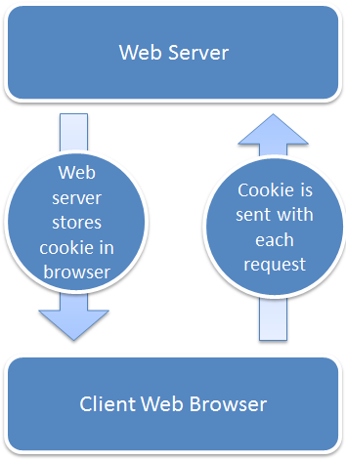
Back-End - PHP Cookies
The most interesting thing about the back-end is that we’ve used cookies to be able to turn multiple leds on/off.
The process isn’t complicated at all, we basically have a cookie set for every led (it keeps track of its current state).
When you login, all the cookies are “unset”.
You can “set” them by pressing the turn on/off buttons. While the cookie is set, the specific led doesn’t turn on/off until you press the reset button.
Also, we’ve made the site in such a way that when you log out of the site, the leds are automatically unset.

Slide 20
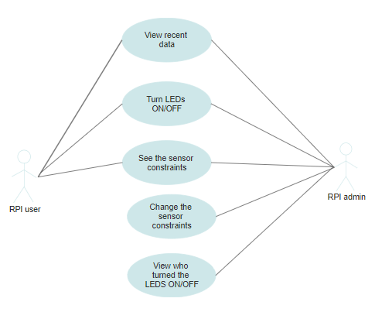
Use cases
As seen here, there are some differences between what the normal user and the admin can do.
Mainly, the admin can change when the sensors turn on and see who turned the sensors on/off.

Slide 21
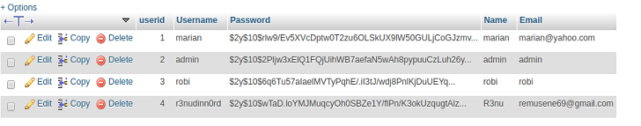
Features - 1
The possibility of having separate admin and user account with hashed passwords

Slide 22
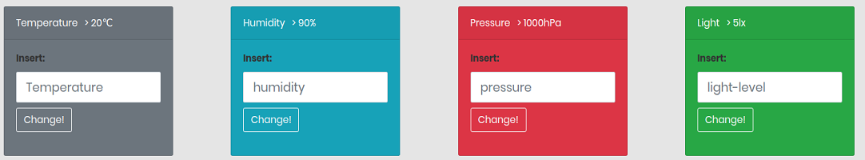
Features - 2
Change the bounds at which the sensors turn on (as an admin)

Slide 23
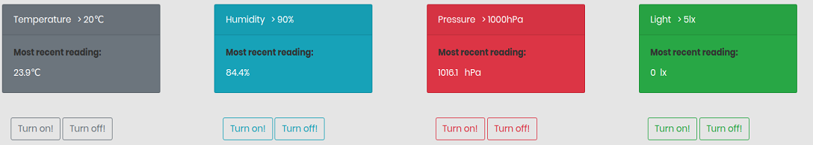
Features - 3
Turn the leds on/off until you reset them

Slide 24
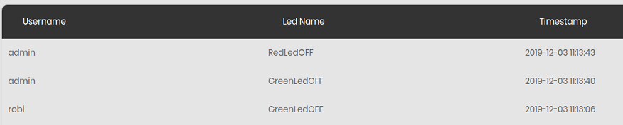
Features - 4
Know who turned leds on/off using PHP sessions

Slide 25
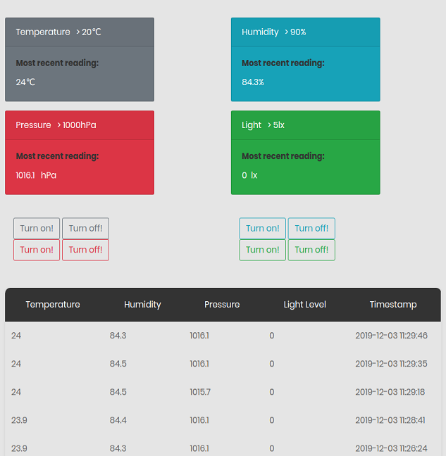
Features - 5
With the help of bootstrap, the website is mobile-ready

Slide 26
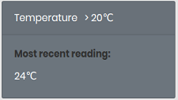
Features - 6
See the current set bounds as any user (e.g. here the temperature has to be higher than 20°C to turn on).

Slide 27
Thank you for your attention!

